Slide 1

Unveiling Financial News Insights: A Journey through Topic Modeling in NLP for Financial News Analysis
Taifur Chowdhury

Slide 2

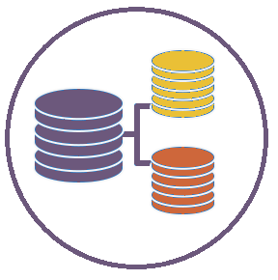




BUSINESS INSIGHT
Corporate financials
Currency
Features:
Sentiment
Text
Insights
GDP
Agreement
Unemployment
Notes:
The fund management department has enlisted our support in analyzing financial news data. Our dataset comprises two key features: sentiments, categorized as positive, negative, or neutral, and text snippets extracted from financial news articles.
Our primary focus areas revolve around assisting asset managers in extracting insights that have impact on their investment strategy and decisions. Our primary focus areas revolve around extracting crucial economic indicators from the dataset. These include corporate financials, unemployment, GDP, agreement, trade, and currency. In addition to economic indicators, we'll conduct sentimental analysis using Topic modeling based on its impact, either positive or negative, on various sectors.
Before we dive into our algorithm, lets look into the current landscape of NLP in financial news. It update us on how asset managers and different professionals in financial industry use NLP algorithms to extract insights.

Slide 3





Current Landscape
Summarization
Asset Categorization
Target and Trends
Cybersecurity
Notes:
Currently, asset managers use NLP algorithms like Topic modeling to extract different types of insights from financials news corpus. First , on high-level, the model can summarize text using news article. It can provide a quick glimpse from the daily news to understand the market for decision making.
Up next we have, asset classification. These algorithms can classify news for the asset managers based on asset category or we can say the topic that is related to the asset, which then assists the algorithm to categorize news based on the topic.
Now to get into more granular level, the algorithms target and spot trends based on different topics in finance. It can identify topics and then track trends on those topics. For example, if a news article is based on electric vehicle then it can understand if the news is on that topic is good bad or neutral. Then it analyzes frequency or co-occurrence of the word across documents which helps the model to detect emerging topics or shift in focus over time. In high level that is how they can spot trends of those discussed topics there mentioned in previous slide.
Last but not least. We can go more deeper here with topic categorization. We know cybersecurity is a big challenge for any organization, especially financial market. The algorithm can be tuned in a certain way where organization or departments who deal with finance can create proprietary topic modeling algorithms which can help them to identify fake news or any kind of questionable activities that stops cyber criminals to infiltrate the organization and bring value to their company.

Slide 4
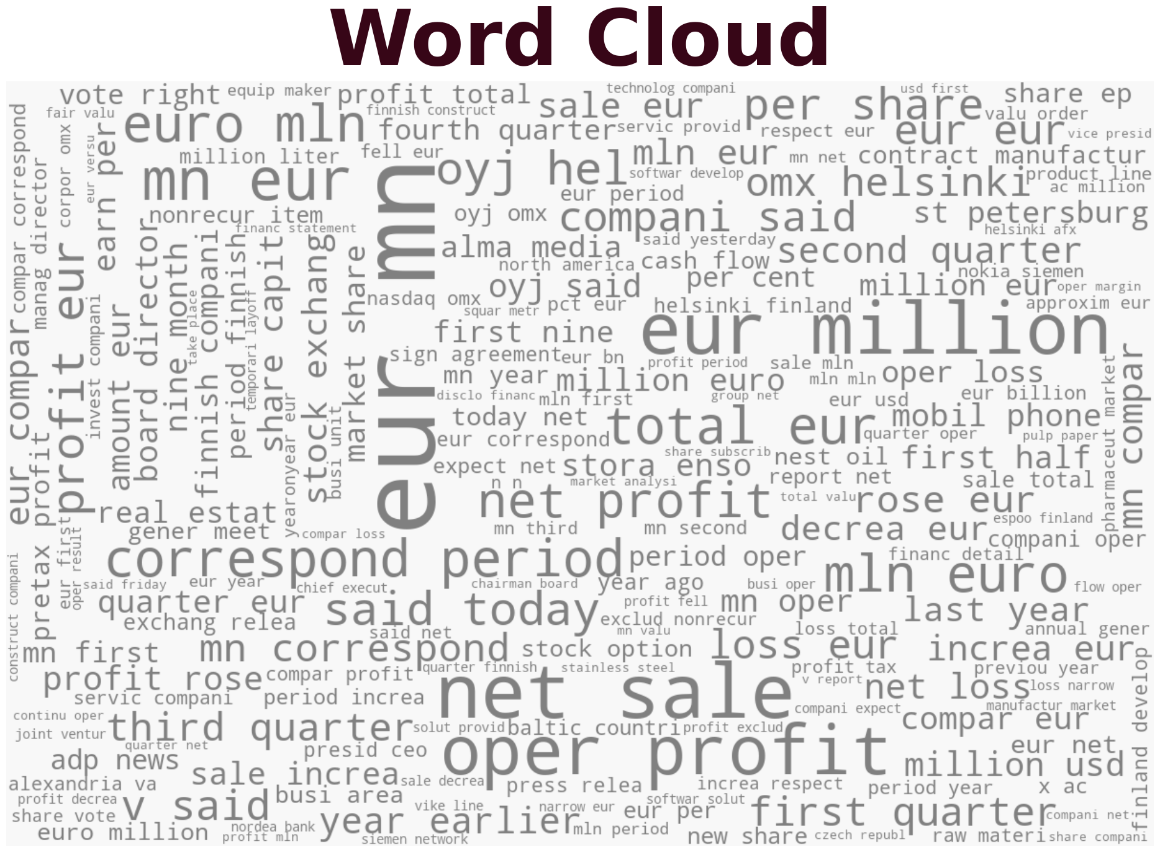

Exploratory Data Analysis
EUR MN
NET SALE
OPER PROFIT
EUR MILLION
Notes:
Next we have word cloud. It is visual representation of data. It is used to depict keyword metadata or to visualize free form text. This format is useful for quickly notice the most prominent terms to determine its relative prominence or to see patterns within a large set of words. In our dataset , if we want to prominent words or phrase we notice – EUR MN, NET SALE, EUR MILLION, OPER PROFIT. This further reveals our dataset has a lot of eur based transaction news, mostly related to financials.

Slide 5
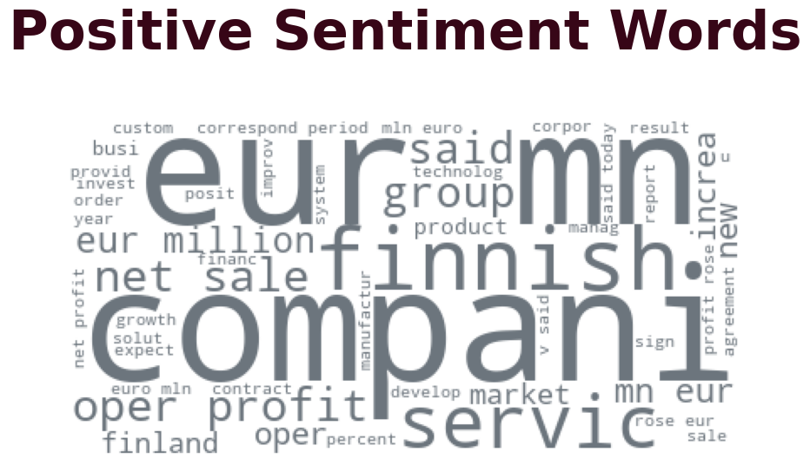
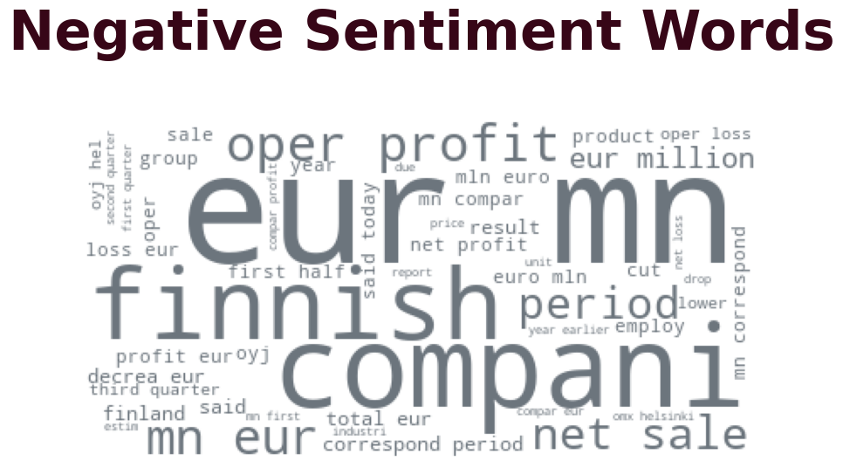
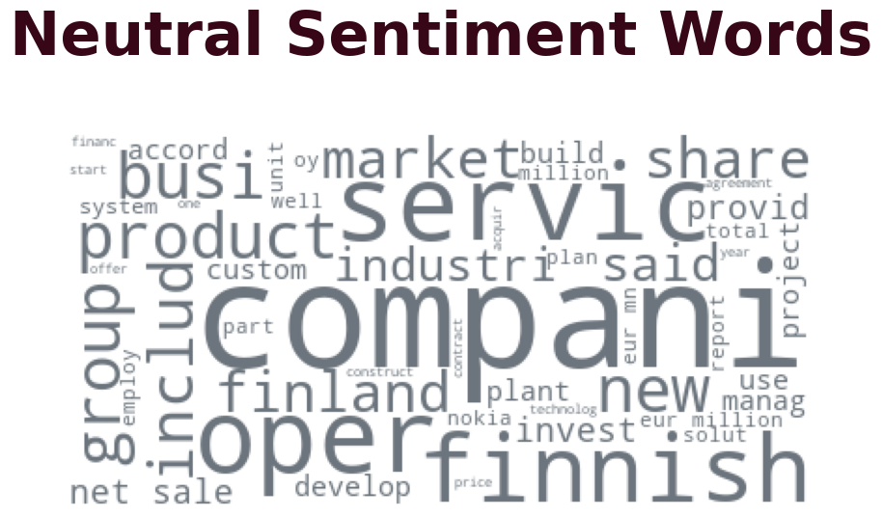
Wordlcoud by sentiment
EUR, MN, Company, Finnish
Finnish, EUR, Company, Mn
Oper, Company, Service, Finnish
Notes:
Here we have wordcloud broken down by sentiment. We notice EUR, COMPANY FINNISH appears in both negative and positive sentiments. Finnish appears a lot in all three sentiments. This further shows we have news out of Finland a lot. This depiction helps us to derive theme from our corpus. Which is news regarding Finnish company financials.

Slide 6
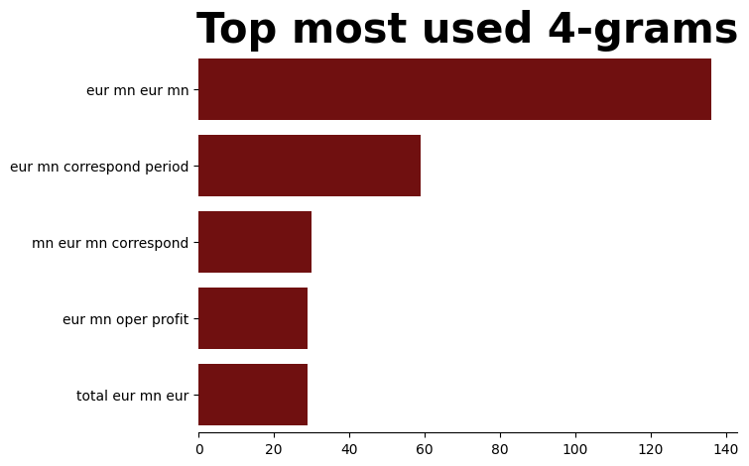
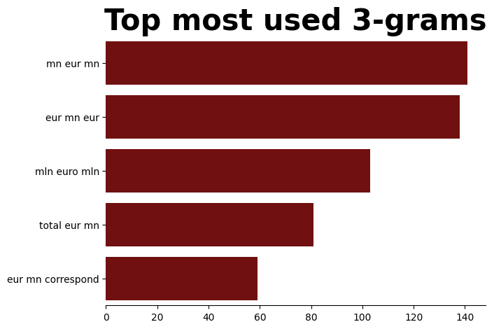
N-Grams
Notes:
N-grams - Now if we want to see the frequency of the phrase chunks, we can look into n-grams. N-grams is a contiguous sequence of n items from a given sequence of text.
Emphasize that in the context of natural language processing (NLP), these "items" are typically words or characters. If you have sequence of two adjacent elements or sequence of two words then its bi-gram. Here we have an example 'EUR MN' is the most frequency sequence of two adjacent words in our corpus. We can also look into tri-gram. It consists of three adjacent elements (words or characters) in the text. Here we have a tri-gram frequency chart. We also notice "mn eur mn" the most frequent repeated word.
What this does is to assist NLP models to predict the next set of words. It helps to generate coherent text based on input. For topic modeling it helps the algorithm to understand context, improve coherence as it captures the impression from set of adjacent texts, and learn how to express ambiguity in language.

Slide 7
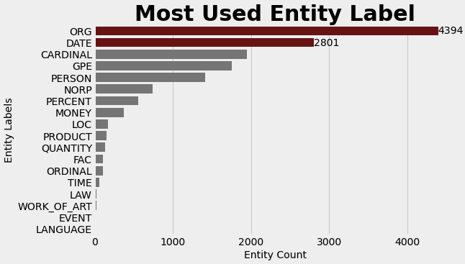



Named Entity Recognition
Notes:
Another method of extracting from text is Named Entity Recognition. It detects and categorizes important information for NLP models. It involves categorizing words such as names, locations, companies, events, dates, and products. By understanding these entities, the model can accurately predict the subjects from corpus. It can understand context and semantics of the text, leading to more coherent topics.
Here we have a chart that list the frequency. On Y-axis we have a list of entities, If you notice the organization and date entities have the highest counts. It tells us that these recent news are about different who are dealing with various financial transactions in Nordic countries and other European countries- mostly in Finland. On the right, for both of those entities, we notice the most frequent words that are in those two respective entties. We noticed EUR has the most counts for ORG, and for DATE entity most of the news are from 2009 and Today. That tells are most of the news are recent Using all these entities the model can accurately build its functionality and extracts meaning full topics.

Slide 8
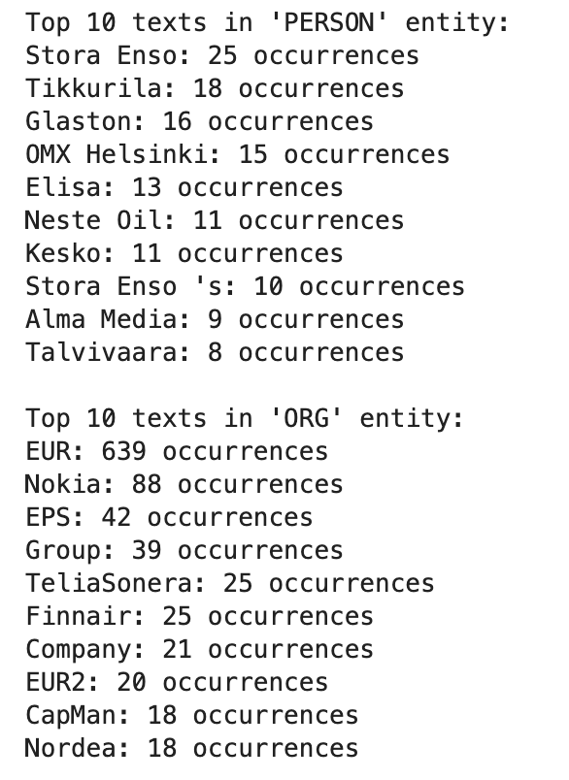
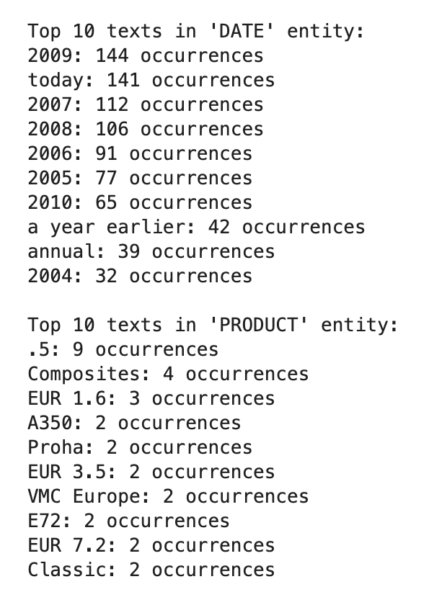
Named Entity Recognition
Notes:
Here we have a breakdown of those entities - we included person, organization, date, and product entities. For all four of those entities we extracted the top 10 records that have most occurrence in those respective entitles. This can give us a glimpse of the content of corpus. For instance, as we noticed in the previous slide, ORG and Date have the most number of frequencies. Under ORG, EUR has the highest number, and for date, 2009 and today have the highest number. That can tell us that our corpus has a lot of recent news about organization that are located in EUR or in Finland. Now, we also included person and product entities since the list in each of those are easy to interpret. Plus it is interesting to see if there are any specific items or name of a person that repeats so then we can further develop our story. Under "Person", we notice Nordic names which confirms our belief that most of the news are from Finland or neighboring countries. Under product, the items are mostly financial product which makes sense as our corpus deals with finance.

Slide 9
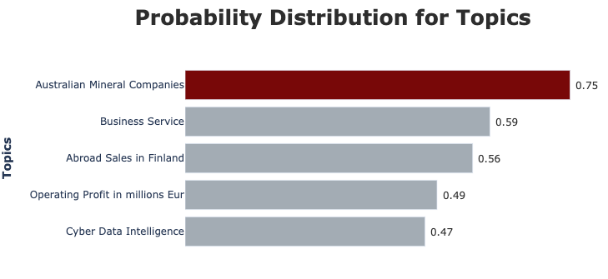

Topic modeling
Greater Relative Importance
Significant Coverage:
Industrial Development
Commodity Prices
Geopolitical/Corporate Events
Decision Making Implications
Notes:
This slide starts to show how our topic model, can start to provide us insides. We used BERTopic model. Using this ML technique, the model automatically groups similar topics into clusters. This can help us to interpret and analyze the clusters. It utilizes advanced language models based on BERT (Bidirectional Encoder Representations from Transformers) to understand the semantic meaning of words and texts.
This makes it an effective tool for tasks like summarizing large datasets, identifying trends, and extracting key themes from textual data.
This chart shows probability distribution for topics. The y-axis of the graph represents different topics identified by the model, while the x-axis shows the corresponding probabilities assigned to each topic. The fact that "Australian Mineral Companies" has the highest probability of 75% suggests that this topic is prevalent and prominent in the analyzed financial news dataset. Investors and analysts can interpret this insight to infer that discussions or news articles related to Australian mineral companies are frequent and significant within the context of the corpus.
For Relative importance, the higher the probability assigned to a topic, the greater its relative importance or prevalence within the dataset compared to other topics. In this case, the 75% probability suggests that "Australian Mineral Companies" is one of the most dominant themes in the financial news articles analyzed.
The asset managers can interpret the high probability as an indication that this topic is receiving significant attention. This could be due to various factors such as industry developments, commodity prices, geopolitical events, or corporate activities related to Australian mineral companies. It can help them to extract quantitative details for their in-depth analysis.
Decision Making: Understanding the significance of this topic can help investors make more informed decisions, particularly if they have investments or interests in the Australian mining sector. It highlights the importance of monitoring news and developments related to Australian mineral companies when assessing investment opportunities or risks.
We can also examine the probabilities associated with other topics in the graph. This allows for a comprehensive understanding of the range of themes present in the financial news dataset and their respective degrees of prevalence. For instance, topics with lower probabilities may still be relevant but are comparatively less dominant in the dataset.

Slide 10
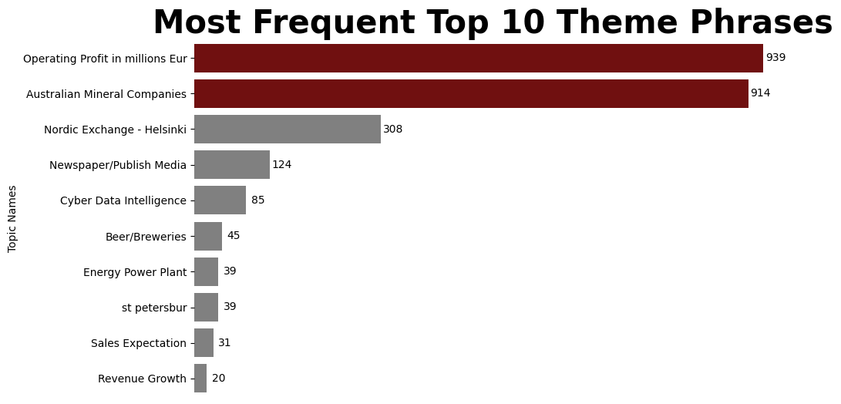

Topic modeling
Financial Health And Performance
Mining Operation
Commodity Prices
Regulatory Changes
Notes:
Next, we can see how the model can extract top themes from our corpus. Each bar represents a theme or topic, while the length of the bar indicates the frequency or count of occurrences of that theme within the dataset.Bars r with counts greater than 400 count are highlighted in maroon, while those with lower counts are displayed in grey. "Operating Profit in millions Eur" or "Australian mineral companies" have the highest count which makes sense a lot since this corpus is on financial news. As previous slide showed Australian mineral companies news are more significant to the corpus which can confirm that this theme signifies news and information pertaining to companies operating in the mineral industry in Australia. This could include developments in mining operations, commodity prices, regulatory changes, etc.
We also notice that operating profits of companies, expressed in millions of euros is crucial for investors and analysts to assess the financial health and performance of companies. Financial news often has quantitative figures in currencies so that makes sense why this theme is frequent.
Both of these charts can help asset managers organize news by themes and topics relevant to their specific portfolio areas. Additionally, they can assist in making timely and efficient decisions by providing the appropriate insights and data.

Slide 11
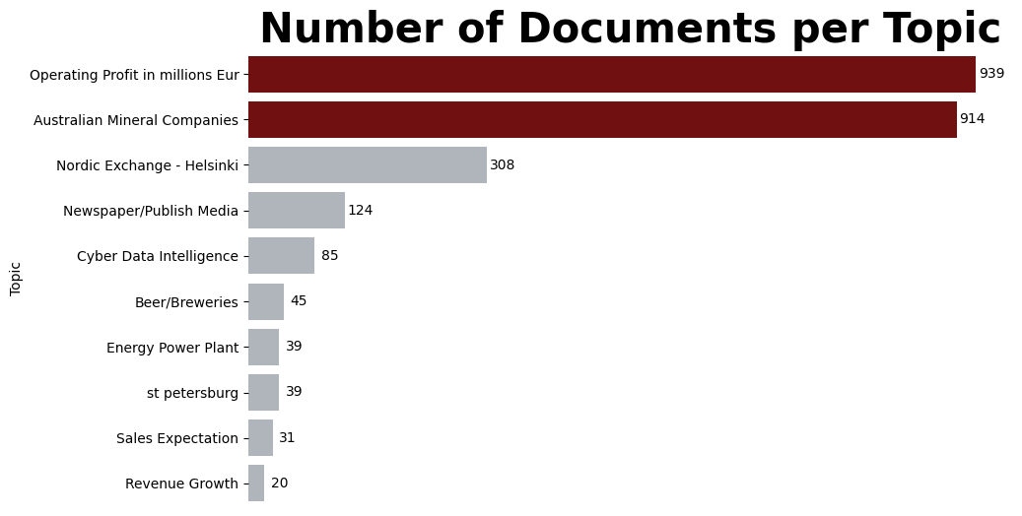

Topic modeling
Company Profitability
Commodity Market
Document Distribution Matters
Practical Implication

Slide 12

Next step
More diverse news.
Further Hyperparameter Tuning
Model Stability Over Time
Impact on KPIs:
Market Trends
Risk Management
Sector Rotation Strategy
Alpha Generation
Notes:
Next step, we can definitely enhance the model in order to extract more insights.
We can get more diverse news. We notice these news are more about Nordic countries financial news. We can gather more news with regards to those countries or other countries that are in business with them. The more news we have the more and precise insights we can gather for the asset managers.
After we gather more news, the model will have to be tuned. In that case, we will have to add more parameters or adjust the current parameters so then the model can provide insights in optimal level.
Another important aspect is we have to monitor the model over time in order to understand its performance. We have to make sure it is consistent with its performance so then the managers can trust the insights.
Lastly, we can start to understand and present different kips' that the managers can rely on and make decisions based on different topics for overall portfolio. We can break downs the kpis based on:
market trends - based on news with most frequent themes, we can extract and present the financial trends.
Risk Management - Identify potential risks by monitoring heavily covered topics, such as Australian minerals.
Sector rotation strategy - Rotate strategy based on change of themes from updated corpus or additional news. It can help the managers to be flexible with their decision making strategy.
alpha generation - insights from financial news data can potentially contribute to alpha generation strategies. This is where, by identifying underpriced or mispriced assets based on the information embedded in news articles, investors can generate excess returns relative to a benchmark index.

Slide 13







Topic Modeling Timeline
Approx. Time Frame: March 4th , 2024 – May 24th, 2024
Model
In
Production
Understand
Business
Requirement
Review Model
And
Dashboard Building
Data Pre-processing
And Cleaning
EDA
Topic Model
Building
Initial Model
Run
Week 1
Week 2 - 4
Week 5
Week 6 - 8
Week 9 – 10
Week 11 – 13
Week 11 – 13

